Slide 1
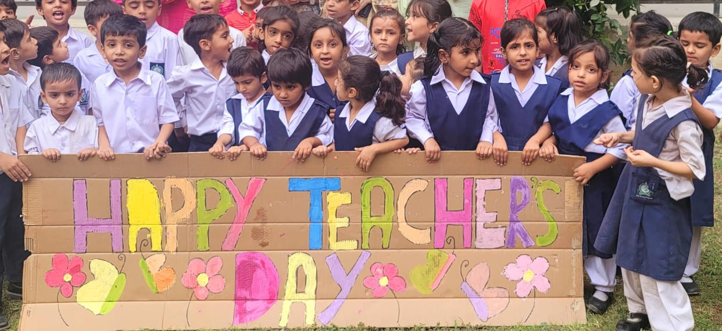
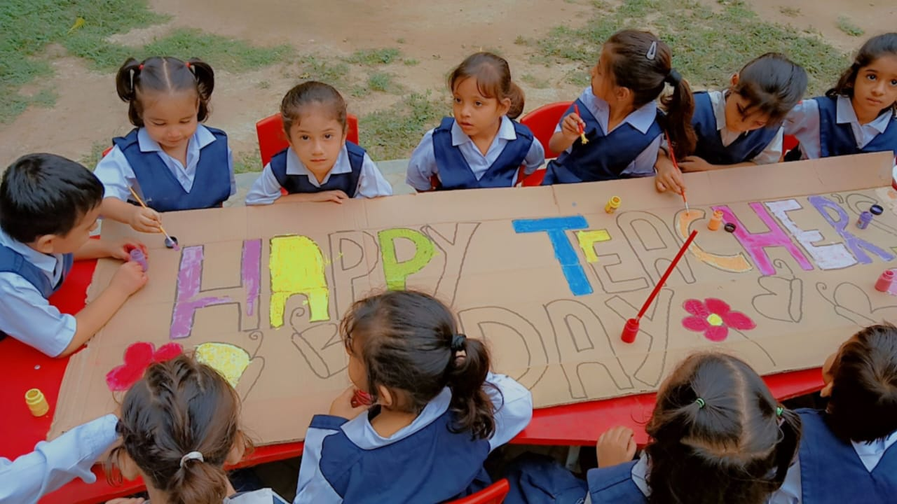
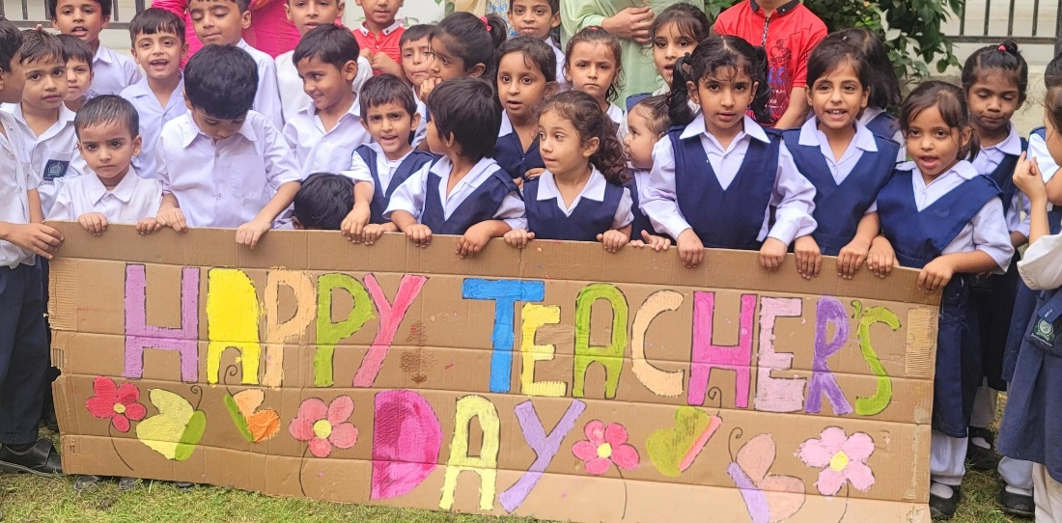
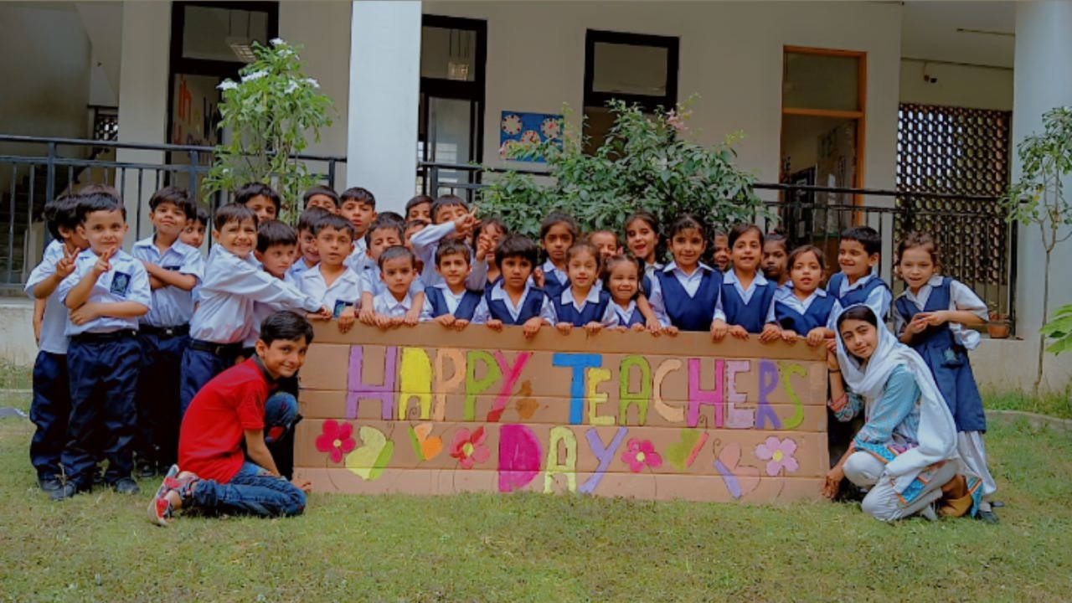
GBPS Sindhi Jamaat Cooperative Housing Society SEMIS Code: 408170153 Happy Teachers Day

Slide 2

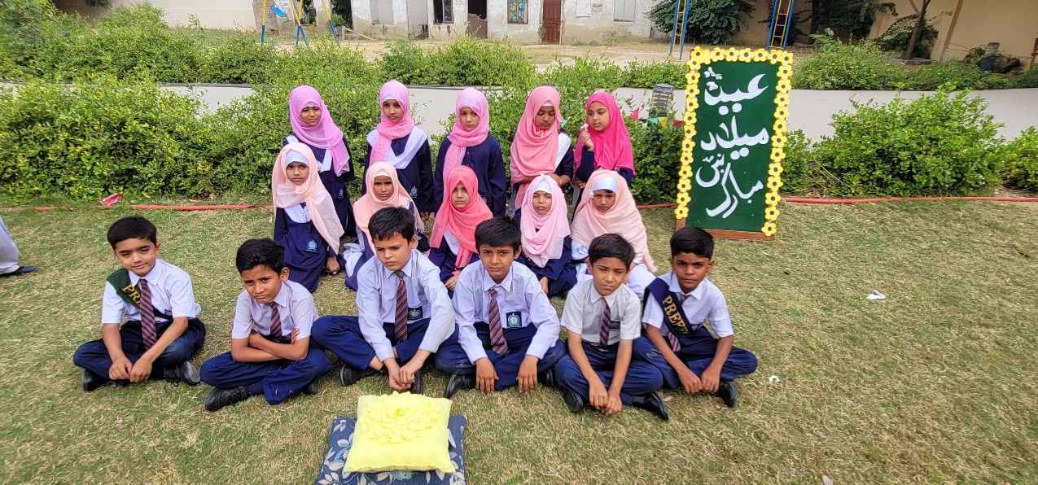
GBPS Sindhi Jamaat Cooperative Housing Society SEMIS Code: 408170153 Eid Milad-Un-Nabi

Slide 3
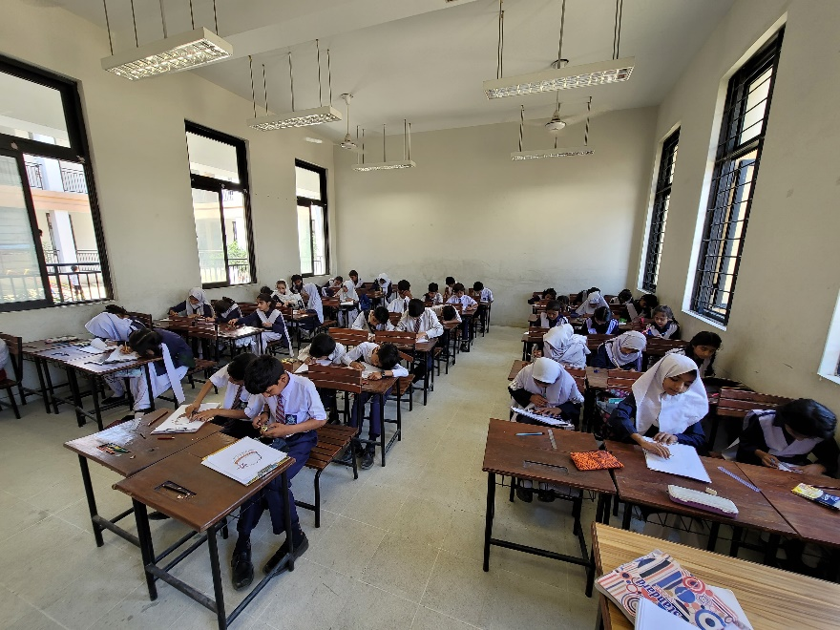
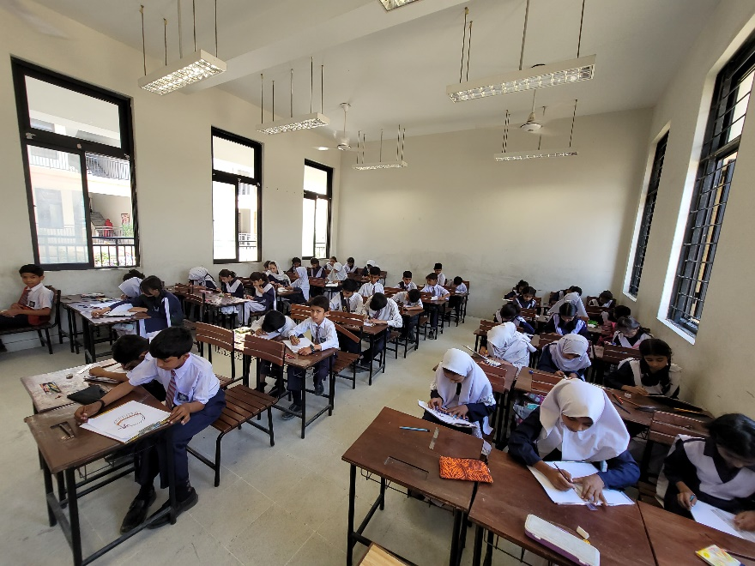
GBPS Sindhi Jamaat Cooperative Housing Society SEMIS Code: 408170153 Assessment

Slide 4
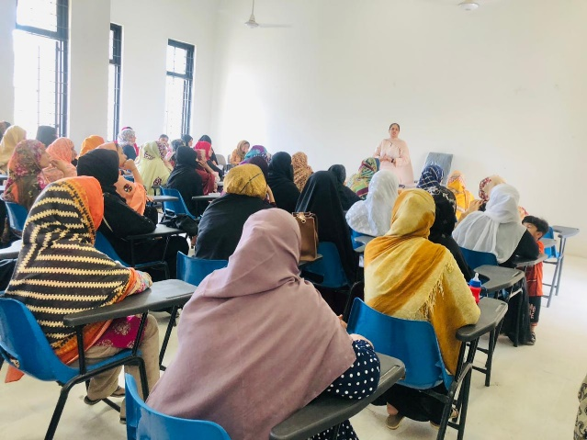
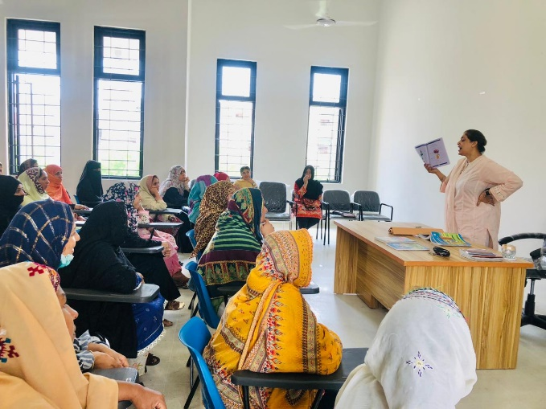
GBPS Sindhi Jamaat Cooperative Housing Society SEMIS Code: 408170153 Parents Teacher Meeting (PTM)

Slide 5
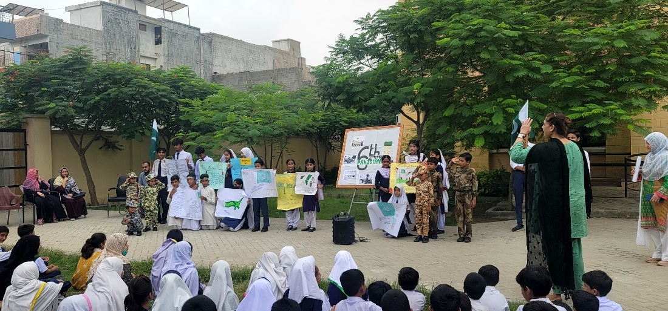
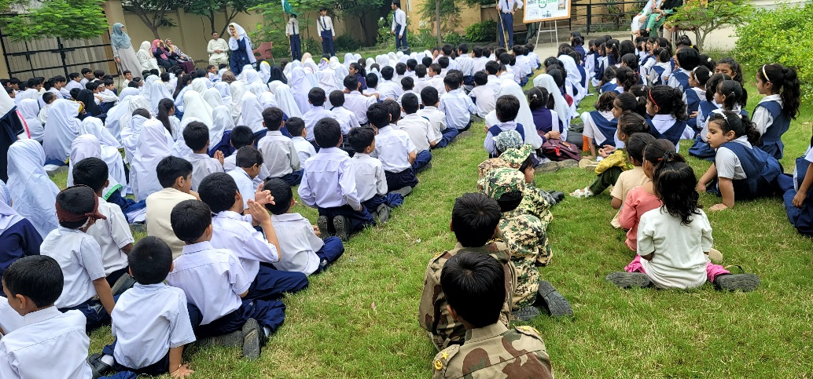
GBPS Sindhi Jamaat Cooperative Housing Society SEMIS Code: 408170153 6 September Defense Day

Slide 6
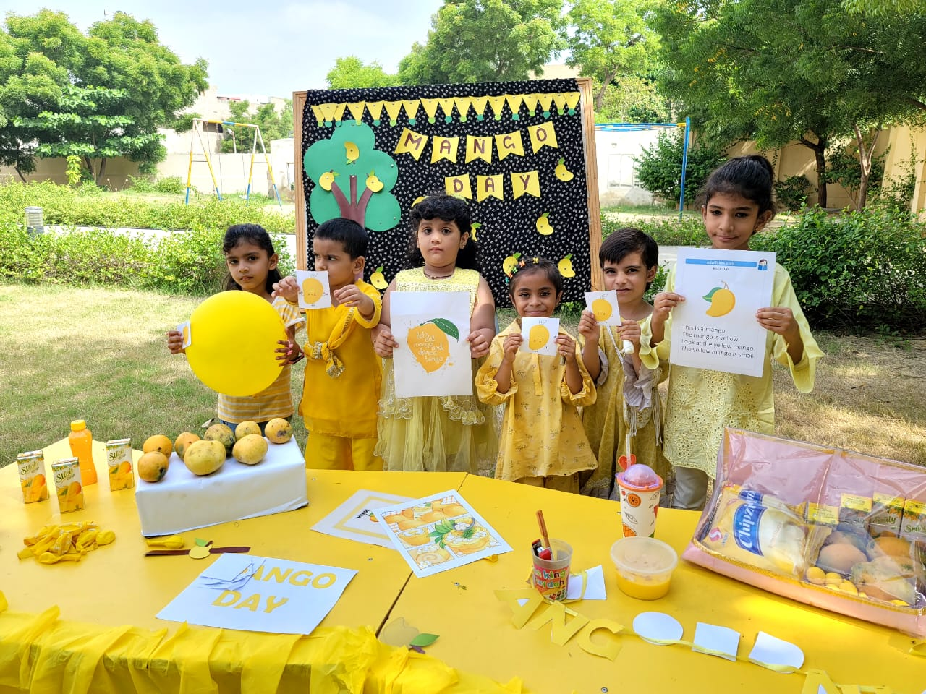
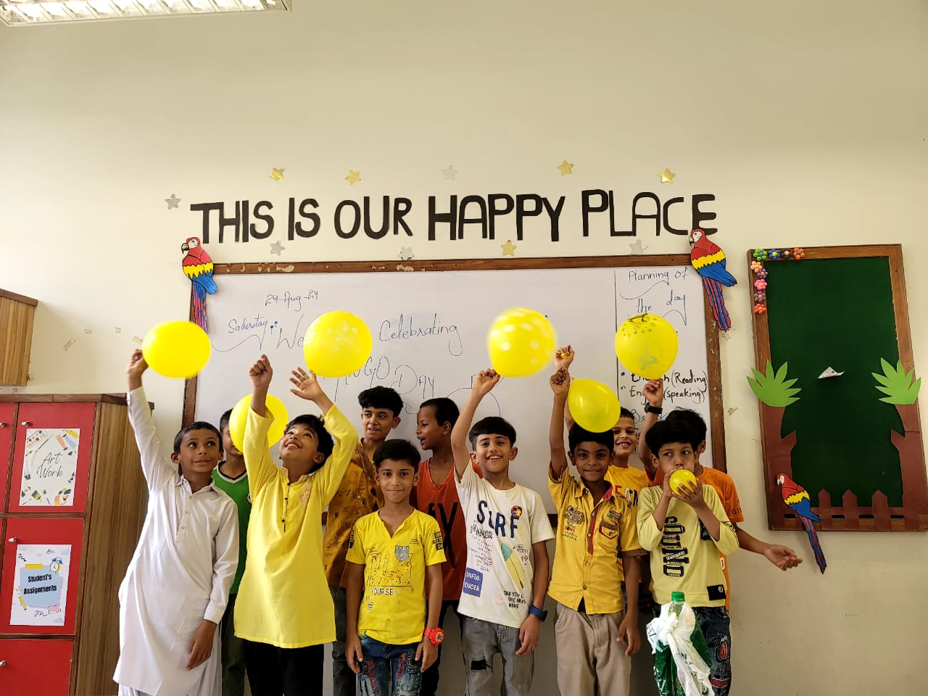
GBPS Sindhi Jamaat Cooperative Housing Society SEMIS Code: 408170153 Mango Day

Slide 7
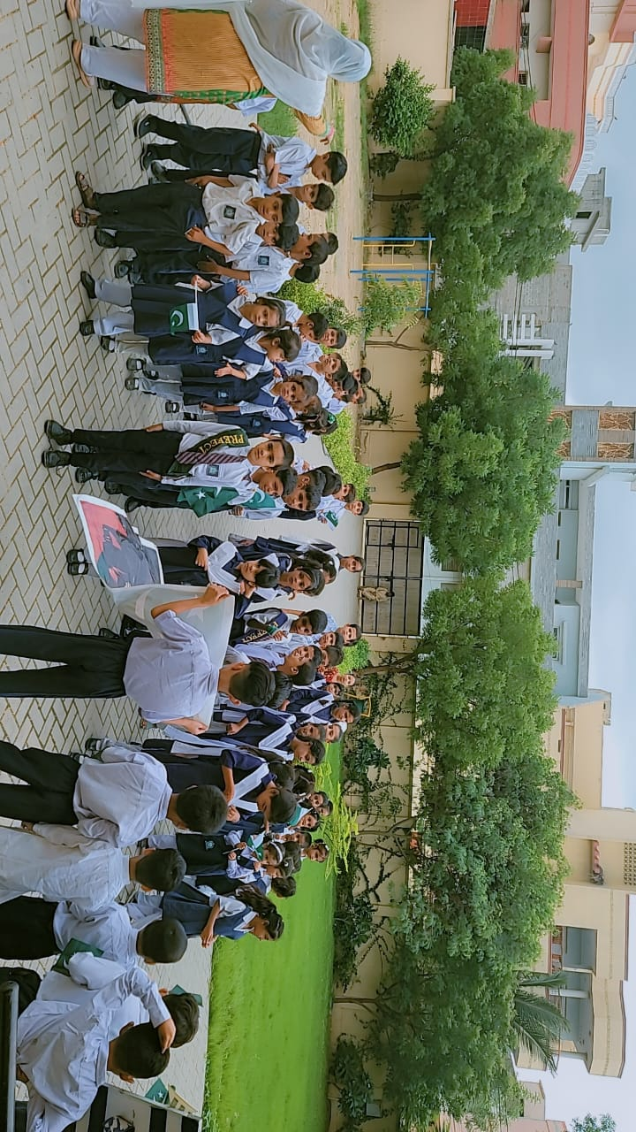
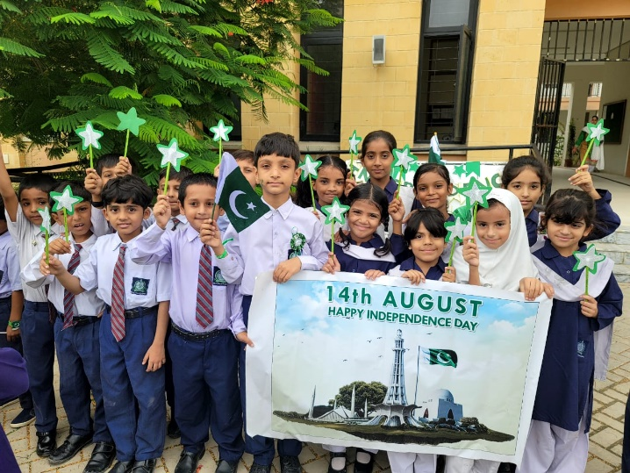
GBPS Sindhi Jamaat Cooperative Housing Society SEMIS Code: 408170153 14 August Independence Day

Slide 8
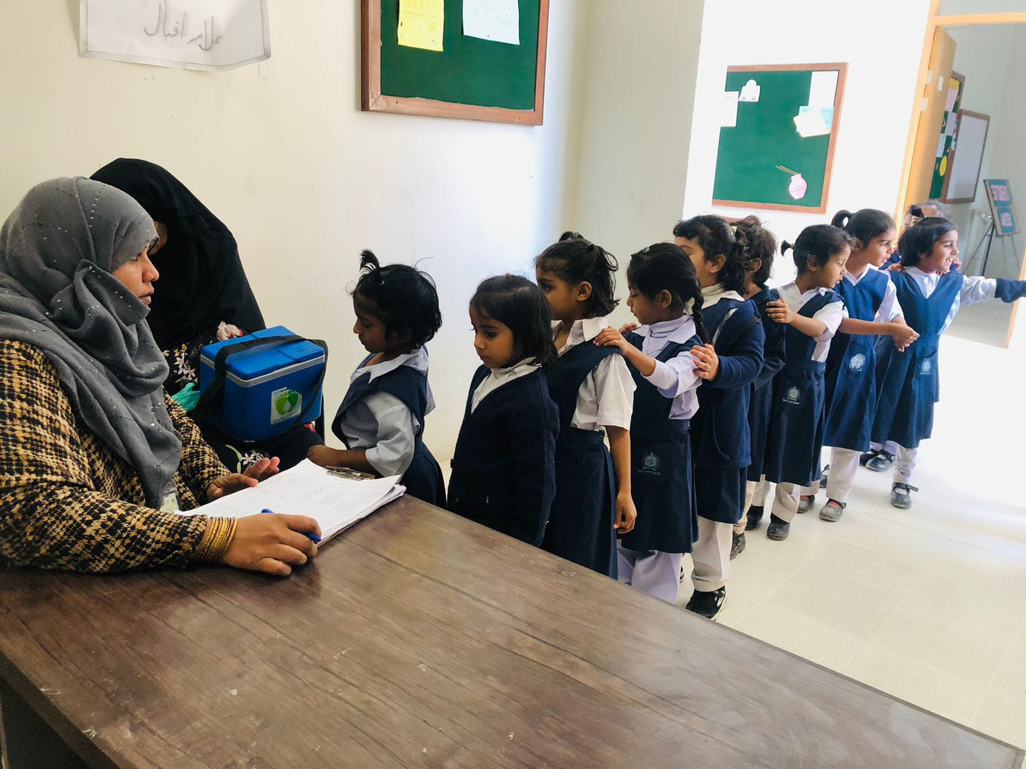
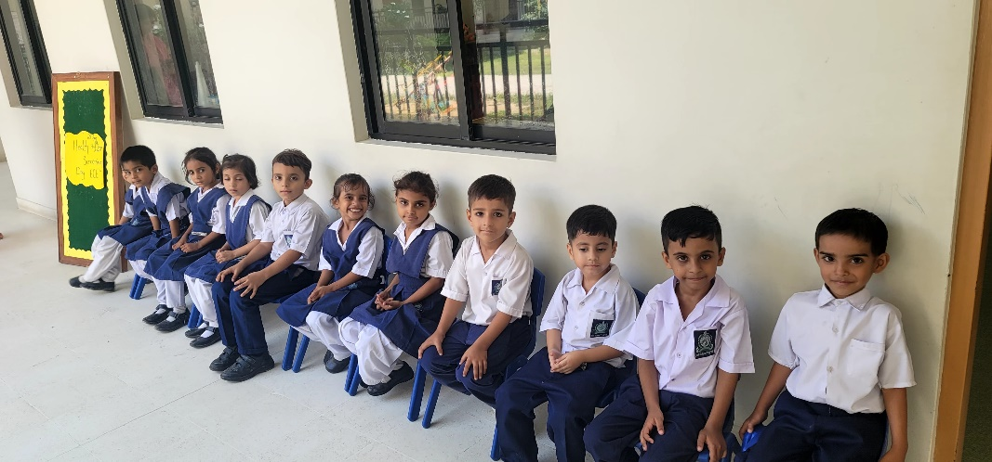
GBPS Sindhi Jamaat Cooperative Housing Society SEMIS Code: 408170153 Health Screening Day

Slide 9
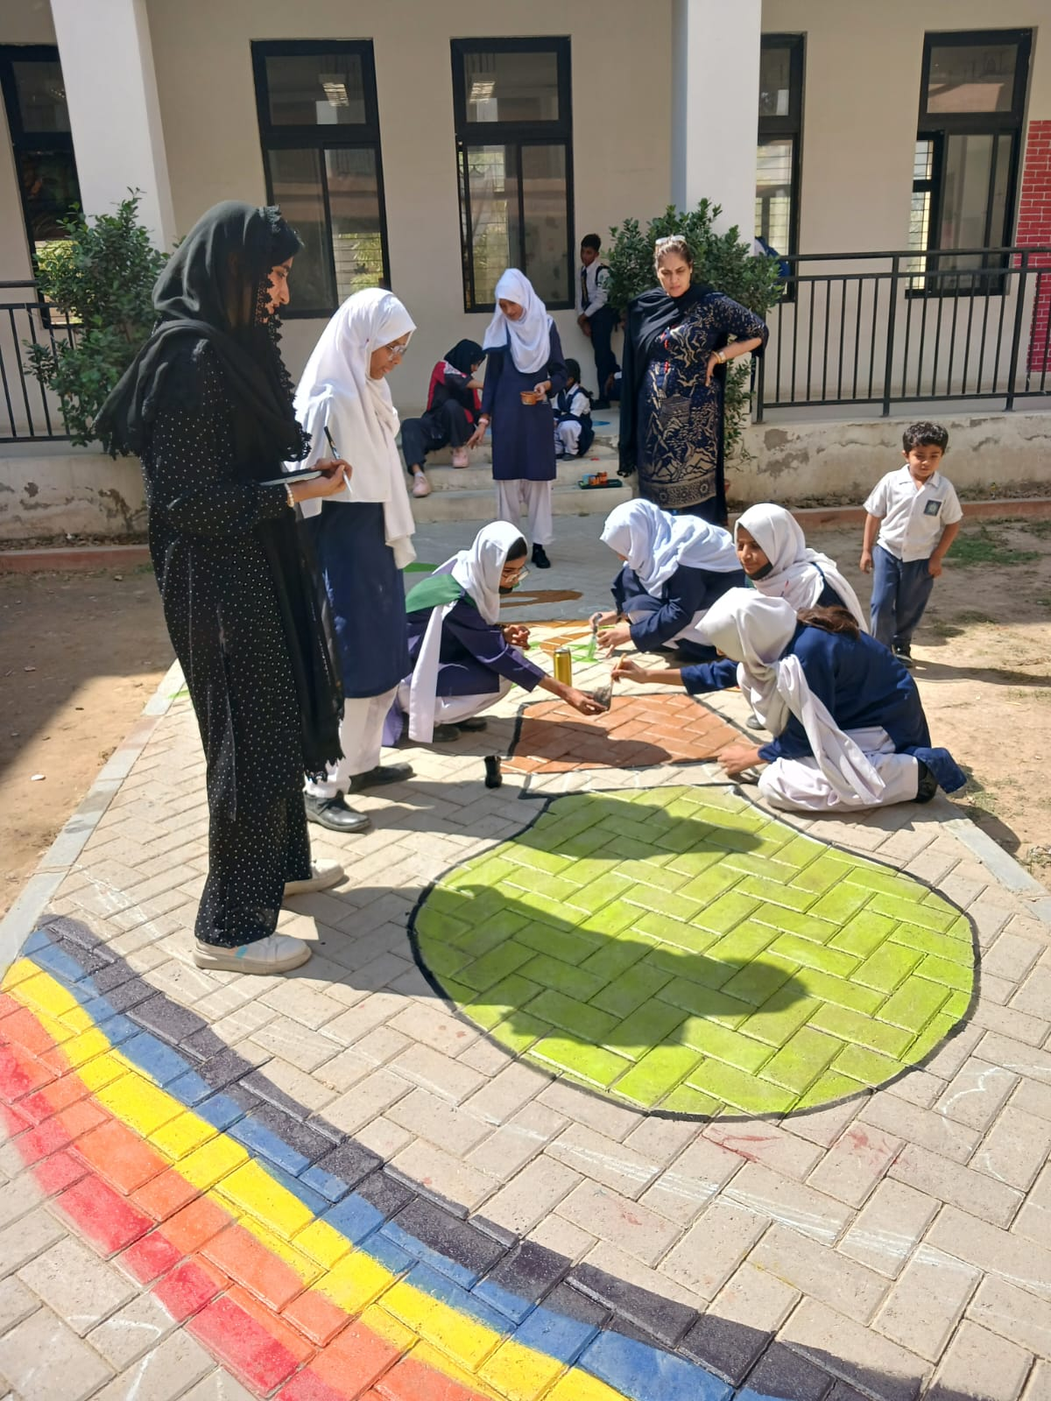
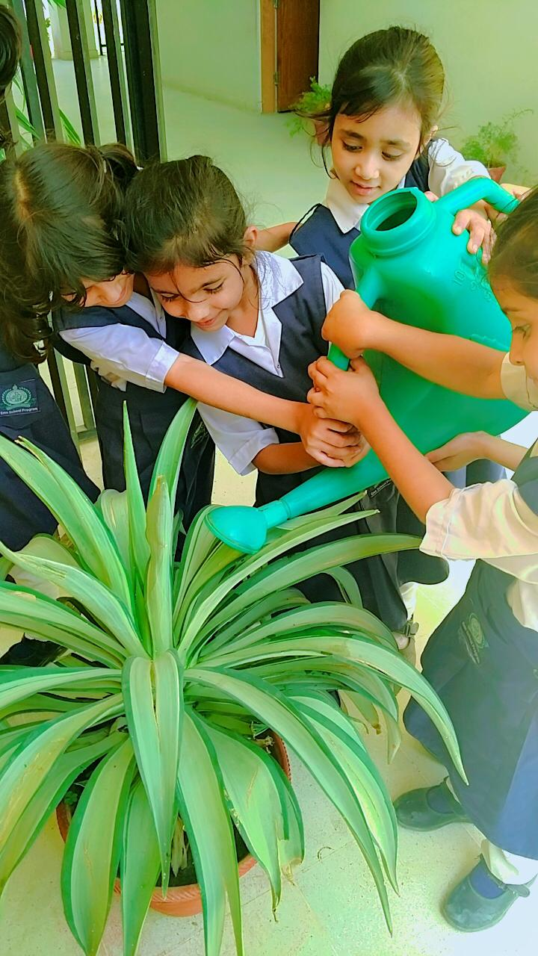
GBPS Sindhi Jamaat Cooperative Housing Society SEMIS Code: 408170153 Art/Plantation Activity

Slide 10
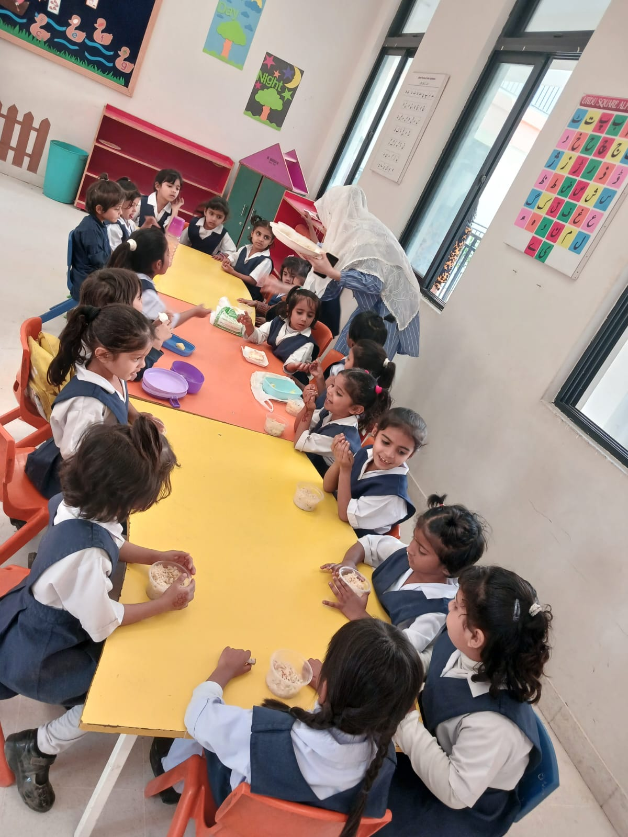
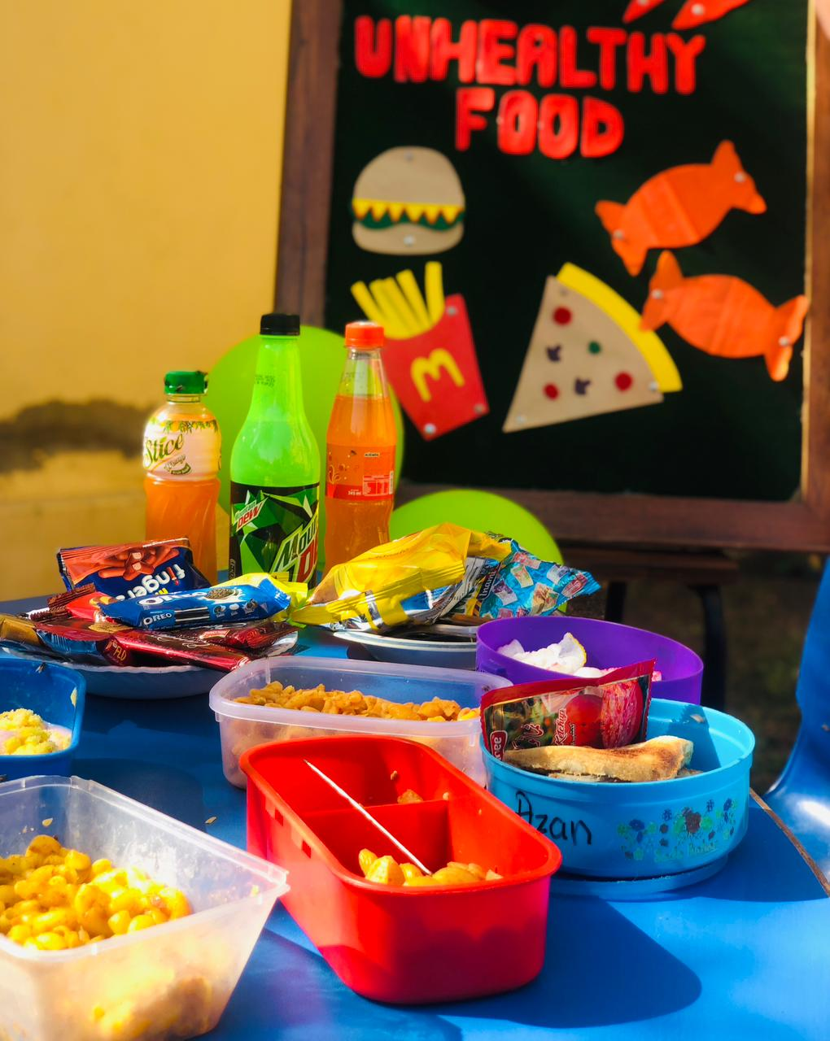
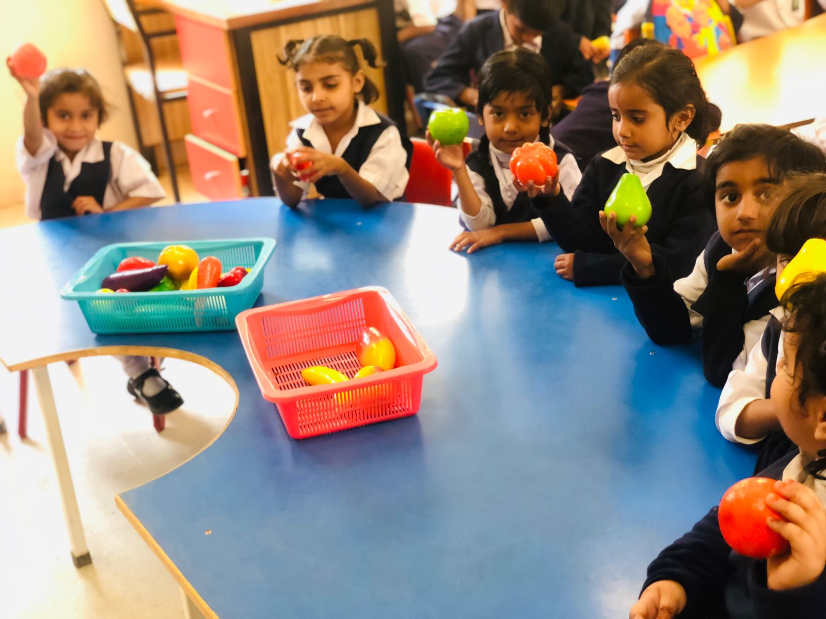
GBPS Sindhi Jamaat Cooperative Housing Society SEMIS Code: 408170153 Healthy Food Day

Slide 11
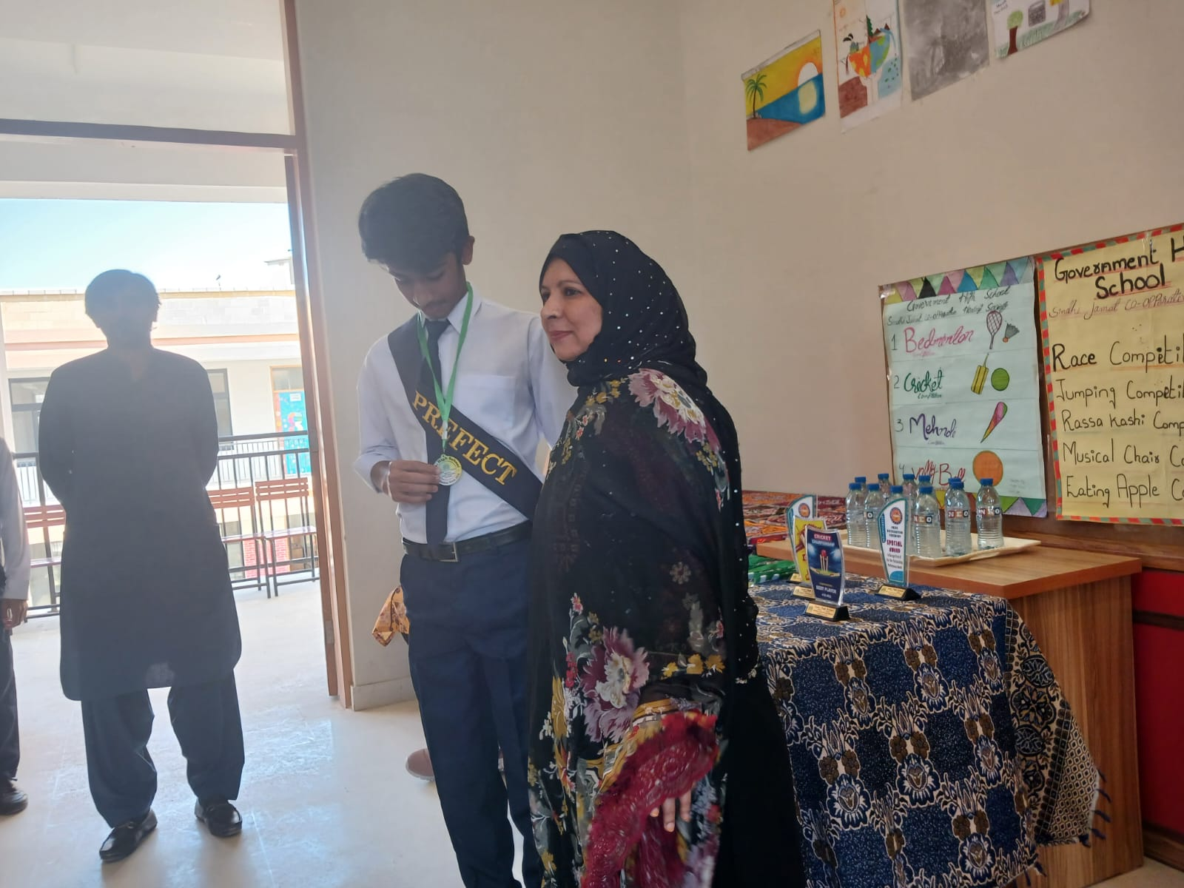
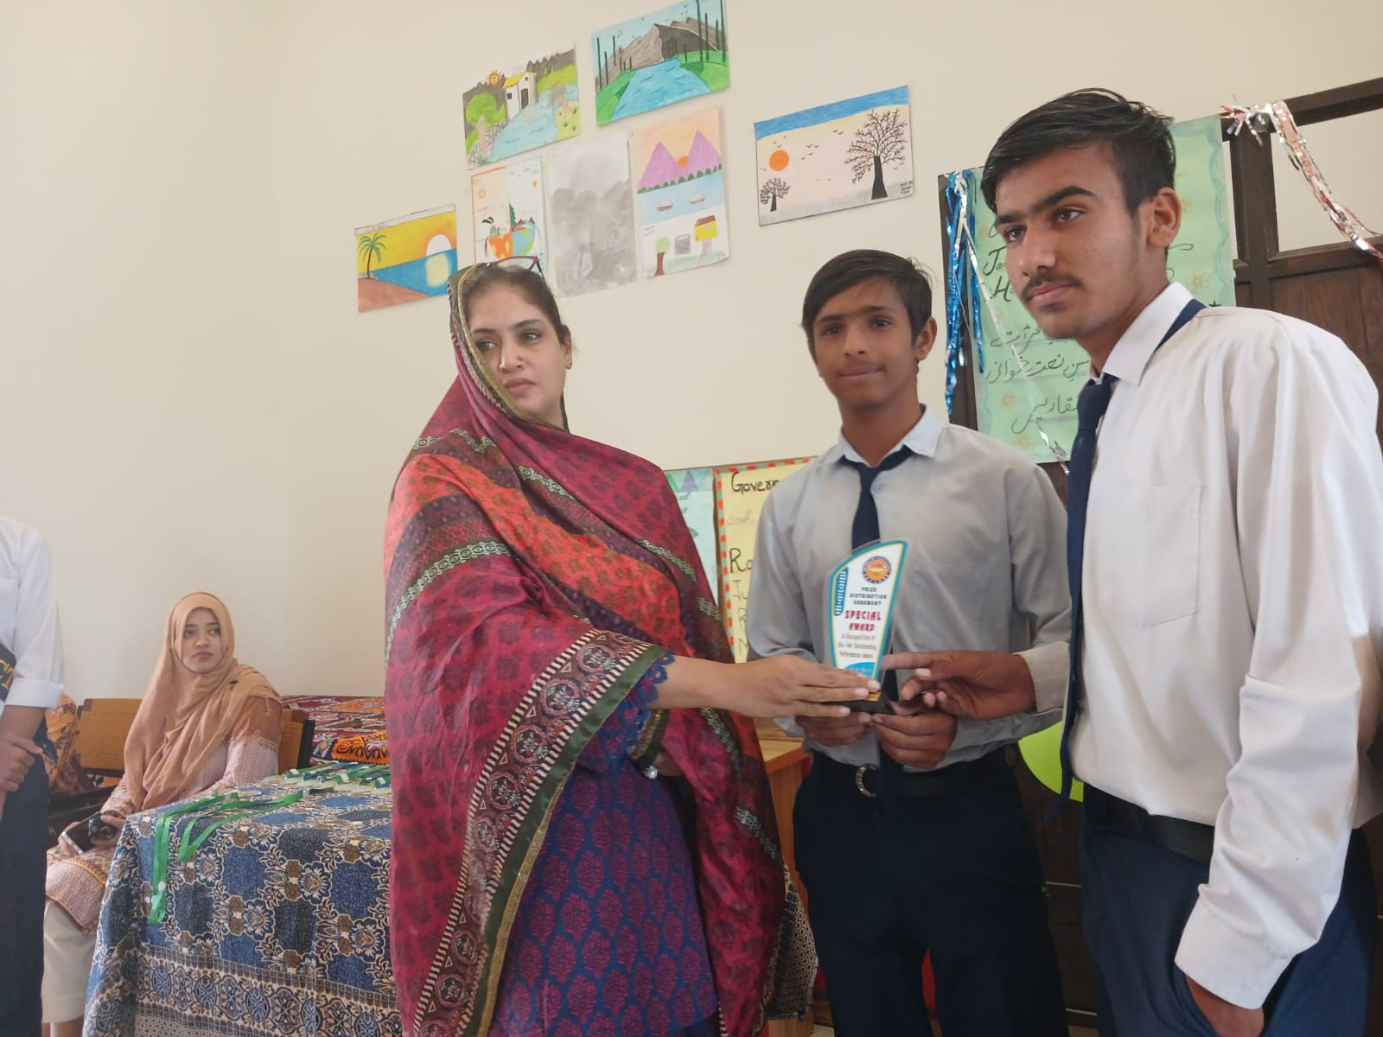
GBPS Sindhi Jamaat Cooperative Housing Society SEMIS Code: 408170153 Iqbal Day

